Slide 1


Constituency Connect
Group Members:
Muhammad Ahsan 21-ARID-737
Haseeb Ur Rehman 21-ARID-715
Huzaifa Bin Shahzad 21-ARID-719
Supervised By:
Ms. Farkhanda Qamar
UNIVERSITY INSTITUTE OF INFORMATION TECHNOLOGY

Slide 2
Table of Contents
Introduction
Literature Review
Benchmarking
Problem Statement
Proposed Model/Solution
Scope
Tools and Technologies (Market Based)
Final Outcome

Slide 3
Introduction
Prepare at-least two (2) slides to briefly describe your project idea.
Properly reference [1] previously used tools and technologies.
If your FYP is related to research oriented properly add references of the paper [2].

Slide 4
Introduction
Constituency Connect is a web-based application designed to improve communication between constituents (citizens) and their elected representatives.
The platform enables users to report complaints, participate in surveys, track performance, and engage with representatives through real-time updates and virtual meetups.
Core Idea
Provide a seamless, transparent, and efficient channel for citizens to voice their concerns, track issues, and hold representatives accountable for actions and resolutions.

Slide 5
Introduction
Key Features
Complaint Reporting: Allows users to file complaints and track progress.
Performance Tracking: Track the performance of representatives with data visualizations.
Real-Time Updates: Stay informed with live updates on complaint statuses, event notifications, etc.
Virtual Meetups: Enable citizens to engage in video conferencing sessions with representatives.
Surveys and Polls: Gather feedback on public issues through interactive surveys and polls.

Slide 6
Literature Review
Prepare at-least five (5) slides and develop a base for your project starting from initial technology/research.
Properly reference previously used tools and technologies [3].

Slide 7
Literature Review
FixMyStreet:
FixMyStreet is a web-based platform that allows citizens to report public service issues (potholes, streetlights, etc.) directly to local authorities, improving local governance and transparency.
Features:
Location-based reporting
Reports are visible to everyone, encouraging public accountability.
Easy-to-use interface for submitting complaints.
Many local authorities integrate FixMyStreet into their internal systems, allowing for automated workflows and streamlined complaint handling.

Slide 8
Literature Review
Shortcomings:
Focus mainly on infrastructure problems, missing broader community engagement features like surveys or virtual meetups.
Does not offer real-time updates and performance tracking for representatives.
Technologies:
jQuery
RequireJS
Nginx

Slide 9
Literature Review
SeeClickFix
SeeClickFix is a platform that allows citizens to report non-emergency issues in their neighborhoods and engage with local governments for resolution.
Features:
Mobile and Web App for easy access and issue reporting.
Direct interaction between citizens and officials, allowing users to receive feedback on the progress of their complaints.
Map-based tracking of problems.

Slide 10
Literature Review
Shortcomings:
Primarily focuses on physical infrastructure issues rather than broader civic engagement.
Lacks features for virtual engagement (like virtual meetup / surveys).
Limited feedback mechanisms for performance tracking
Technologies:
Bootstrap
jQuery
Ruby on Rails
Nginx

Slide 11
Literature Review
Neighbourland
Neighbourland is a civic engagement tool that empowers residents to collaborate on ideas for improving public spaces and local governance.
Features:
Citizens can propose and discuss ideas to improve their neighborhoods, helping to shape government projects and decisions.
Surveys and polls for gathering community opinions.
Focuses on community-driven projects, allowing citizens to follow the progress of initiatives they care about.

Slide 12
Literature Review
Shortcomings:
Focuses more on long-term project-based collaboration rather than short-term problem reporting or complaint resolution.
Lacks real-time features such as live tracking or updates.
No Role-Based Access Control(RBAC) or performance monitoring for local representatives.
Technologies:
Typescript
Apollo JS
Node JS
Nginx

Slide 13
Literature Review
PM Citizen Portal
The PM Citizen Portal is a government-run platform in local landscape designed for citizens to submit complaints and track their resolution by relevant departments.
Features:
Provides a single point for citizens to submit complaints on various issues.
Citizens can track the status of their complaints and receive updates when an issue is resolved.
Integrated with multiple government departments for quick resolution.

Slide 14
Literature Review
Shortcomings:
Lacks real-time notifications and transparency features like performance dashboards for representatives.
Offers basic reporting but lacks detailed analytics and customizable reports for data-driven decision-making.
Unlike more modern platforms, it does not offer virtual meetups, or survey tools to foster direct communication between citizens and representatives.
Technologies:
Bootstrap
jQuery
php

Slide 15
Literature Review
Conclusion
While each system offers valuable civic engagement tools, none fully combine the features of real-time tracking, virtual engagement (meetups, surveys), and performance analytics.
FixMyStreet and SeeClickFix focus on public service infrastructure issues but miss the broader aspects of civic engagement and representative accountability.
Neighbourland fosters long-term collaboration on public projects but lacks features for addressing immediate concerns or complaints.
PM Citizen Portal provides a centralized complaint system but misses out on modern features like real-time updates, detailed analytics, and dynamic civic engagement tools.

Slide 16
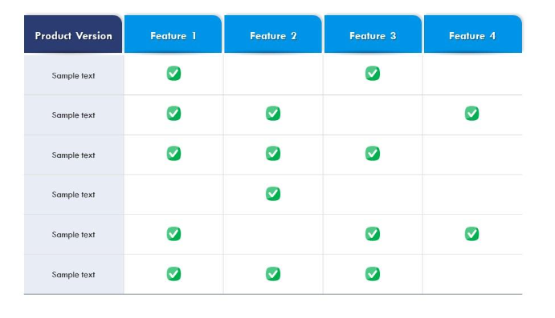
Benchmarking
Once you cover basic understanding of problem, now you will map them in the form of a table to narrow down your problem.

Slide 17
Benchmarking
Features | Constituency Connect | PM Citizen Portal | FixMyStreet | SeeClickFix | Neighbourland
Complaint Reporting | Yes | Yes | Yes | Yes | No
Complaint Prioritization | Yes | No | No | No | No
Virtual Meetups | Yes | No | No | No | Yes
Surveys | Yes | No | No | No | Yes
Event Calendar | Yes | No | No | No | No
Multi Language Support | Yes | Yes | No | No | No
Performance Metrics | Yes | No | No | No | No

Slide 18
Problem Statement
Define your problem in one paragraph keep in mind your literature review limitations and the gaps identified in the benchmarking table.

Slide 19
Problem Statement
Although various complaint management systems exist, significant gaps persist in effectively connecting constituents with their representatives. Current communication channels often lack real-time interaction features, leading to delays in complaint resolution and insufficient civic engagement. This results in delayed problem resolution, reduced accountability, and a growing disconnect between representatives and the public. Citizens face challenges in engaging with their representatives, easily filing complaints, tracking their progress, or receiving timely responses. Consequently, there is a pressing need for a unified solution that fosters better communication, transparency, and efficient governance.

Slide 20
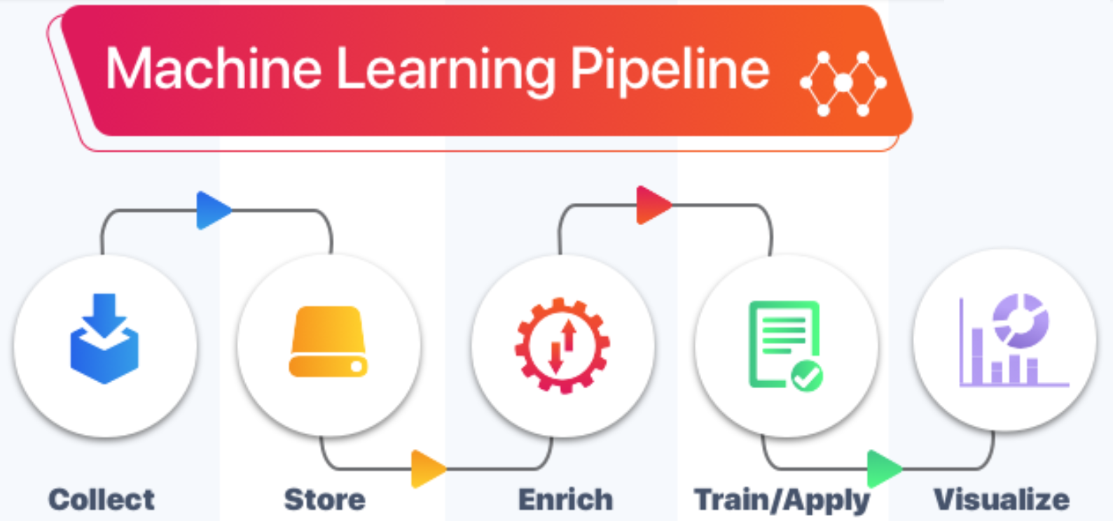
Proposed Model
Write down abstract idea of your project, and add its model diagram

Slide 21
Proposed Solution
Problem Solution
Constituency Connect aims to bridge the communication gap between constituents and their elected representatives by providing a sophisticated platform for transparent, efficient, and real-time communication. The platform enables constituents to submit complaints, track their progress, and interact directly with representatives and relevant departments. It offers multiple channels for communication, including virtual meetups, surveys, and complaint resolution tracking. By integrating features like real-time notifications, detailed performance tracking, and multi-language support, the system empowers citizens, enhances transparency, and encourage civic engagement.

Slide 22
Proposed Solution
Model Diagram

Slide 23
Scope of your Project
Properly write the scope of your project. Avoid general solutions.

Slide 24
Scope
Constituency Connect aims to streamline communication between constituents and their elected representatives, with a primary emphasis on complaint submission, tracking, and resolution. The system will support virtual meetups and enable performance monitoring of representatives. It will cater to multiple user roles, including constituents, representatives, assistants, and department officials, each with distinct access levels and functionalities. The platform will offer a bilingual interface (English and Urdu), concentrating specifically on complaint management and civic engagement. Features such as external application integration, payment processing, or general-purpose community forums are beyond the scope of the project.

Slide 25
Tools and Technologies (Market Base)
List down tools and technologies, you want to use for development purposes. Avoid old ones, explore market oriented tools and technologies.

Slide 26
Tools and Technologies
Tools
Visual Studio Code(VS Code): Lightweight code editor with extensions.
Figma: Design tool for collaborative UI/UX creation.
Miro: Collaborative whiteboard platform for mind mapping.
Draw.io: Diagramming tool for flowcharts and architecture.
Adobe Illustrator: Vector graphics editor for designs.

Slide 27
Tools and Technologies
Frontend Technologies
HTML5 | React JS
CSS3 | Redux To0lkit
Tailwind CSS | Material UI
Bootstrap | React Hook Form
JavaScript | TanStack Query
Backend Technologies
Node JS | Express JS

Slide 28
Tools and Technologies
Database
MongoDB | Mongoose
Authentication and Authorization
Clerk

Slide 29
Final Outcome
Describe shortly the nature of your project outcome.
Whether it’s a Advance Technology/ Product / Framework/ Solution to the existing Problem or a novel research, etc.

Slide 30
Final Outcome
Constituency Connect is a targeted solution designed to improve communication between citizens and their elected representatives. The platform tackles existing communication inefficiencies by facilitating real-time interactions, complaint submissions, tracking, and transparent monitoring of representative performance, all while streamlining complaint management and providing tools for virtual meetings. With real-time notifications and role-specific access, it promotes transparency, accountability, and increased civic engagement. This platform effectively addresses existing gaps by offering an efficient solution for complaint management, empowering both constituents and representatives to engage more meaningfully and enhance civic participation.

Slide 31
References
www.deeplearning.ai (Last visit date 13-09-2024)
M. Habib, A. Hussain, S. Rasheed, M. Ali, Adaptive fuzzy inference system based directional median filter for impulse noise removal, AEU - International Journal of Electronics and Communications, 70 (5), 2016, 689-697, https://doi.org/10.1016/j.aeue.2016.02.005.
…

Slide 32


